Slide 1
Predicting School Bus Breakdowns and Delays in NYC
Capstone Project by Team B
Team Members: Nasim Aalemi, Shobha Panthi, James Gilmore
GitHub Link: https://github.com/naalemi/Predicting_NYC_School_Bus_Breakdowns_Capstone_Project-Team-B-

Slide 2
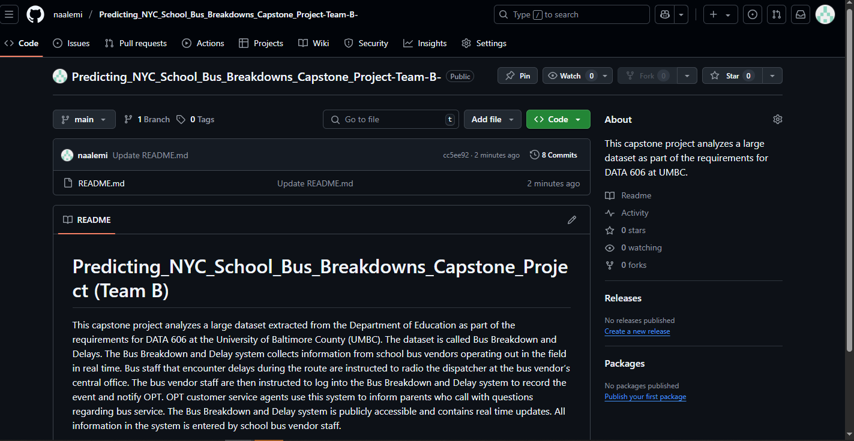
GitHub Page

Slide 3
Project Introduction
This capstone project aims to analyze and model school bus breakdowns and delays in New York City using a large-scale dataset.
In the number one public school system in the United States, a reliable school transportation system is essential for students. Travel breakdowns affect student learning, family logistics, and long term academic success.
Our project will combine exploratory data analysis, machine learning, and interactive dashboards to uncover patterns, predict outcomes, and offer actionable insights.
We are specifically aiming to answer what operational factors contribute most to school bus delays and breakdowns in NYC, and can we accurately predict future incidents based on route, contractor, and historical patterns.

Slide 4
Overview of Similar Studies
Lack of Comparable Projects on School Bus Delay Prediction
Extensive search of academic journals, data science platforms (e.g., Kaggle), and public sector dashboards revealed very limited or no projects focused on Predictive modeling of school bus delays
Integrated tools or dashboards tailored for school transit performance
What Exists Instead
General transit bus status (e.g.,Transportation Status BCPS)
Bus delay or breakdown report (e.g., NYC Public Schools)
General articles highlighting the significance of minimizing bus delays

Slide 5
Motivation and Goals
NYC’s school bus system is one of the largest in the U.S., and delays or breakdowns can impact thousands of students daily.
Unreliable transportation affects student attendance, learning, and family routines.
Many delays are avoidable if we can identify patterns and contributing factors.
Machine learning offers a way to predict future incidents, helping schools make smarter decisions.
Goals
Analyze school bus incident data to uncover key trends and causes.
Classify whether an incident will be a breakdown or just running late.
Predict how long a delay will last using regression techniques.
Develop interactive tools (dashboard or app) to share insights and make real-time predictions.
Support better planning and reduce disruptions for NYC’s Department of Education.

Slide 6
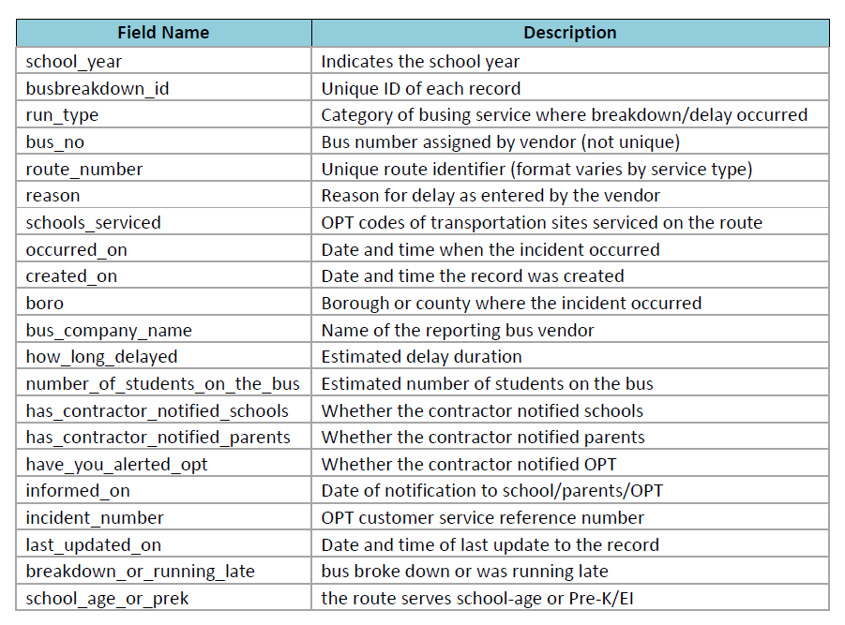
Dataset Introduction
The NYC Bus Breakdowns and Delays dataset is updated daily on the NYC Open Data portal. All other datasets from the NYC Department of Education’s Office of Pupil Transportation (OPT) are published monthly and reflect a snapshot of operational data.
Source Link: https://shorturl.at/OSbdS
Dataset: NYC Bus Breakdown and Delays
Size: 747,173 records
Scope: Multi-year data
The dataset includes:
10 academic years (2015-2016 to 2024-2025)
Incident Information (delays or breakdowns)
Operational Details (reasons, run-type)
Contextual Data (how long, rout, boro, etc)
Response Behavior (notification or alerts)

Slide 7
Dataset Details
OPT does not publish data for July, August, and September because:
a) Most New York City public schools are closed during the summer, resulting in limited and unrepresentative data; and
b) Summer and early fall data is highly unstable due to frequent changes from external systems impacting NYC school transportation.
Features to be used:
School Year, Unique ID, Run Type, Schools Serviced, Boro, How Long Delayed,
Number of Students on the Bus, Breakdown or Running Late, School Age or PreK

Slide 8
Potential ML Techniques
What We Want to Predict
Predict if a school bus incident will result in a Breakdown or just Running Late
Predict how long the delay will be (in minutes)
ML Models to Use for Classification:
Logistic Regression
Random Forest
XGBoost
Evaluation Metrics: Accuracy,Precision, Recall, F1-Score
ML Models to Use for Regression:
Linear Regression
Random Forest Regressor
Gradient Boosting
Evaluation Metrics:Mean Absolute Error (MAE), Root Mean Squared Error (RMSE), R-squared (R²)

Slide 9
Feature Engineering for Classification Model
Target variable: Breakdown_or_Running_Late
Fields | Feature Engineering Notes
Boro | One-hot encode (e.g., Bronx, Brooklyn…)
Bus_Company_Name | Frequency encoding or target mean encoding if too many categories
Run_Type | One-hot or label encode (e.g., AM, PM, To School, From School)
Reason | Group similar reasons (e.g., "Traffic", "Weather") before encoding
School_Age_or_PreK | One-hot encode (e.g., School-Age = 1, PreK = 0)

Slide 10
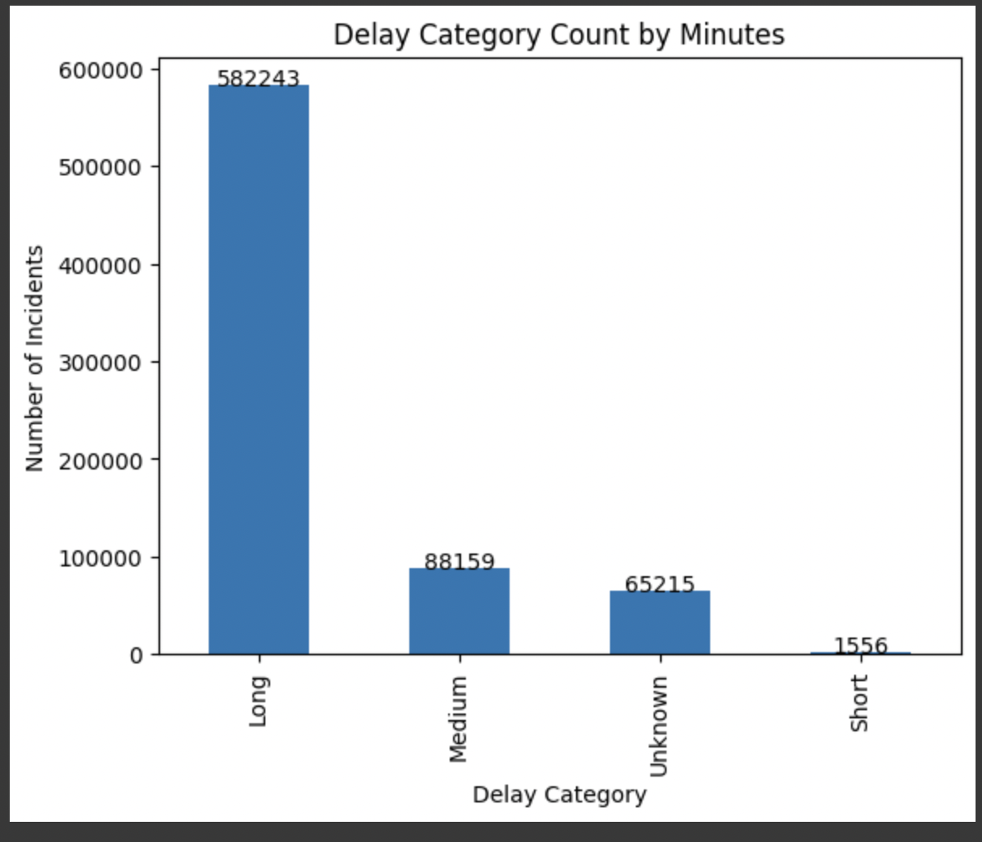
Exploratory Data Analysis
Graph displays the lengths of delays.
This is how we categorized the delay duration:
If the value is missing, we label it as 'Unknown'
If the delay is 5 minutes or less, it's 'Short'
If the delay is between 6 and 15 min, it's 'Medium'
If the delay is more than 15 minutes, it's 'Long'

Slide 11
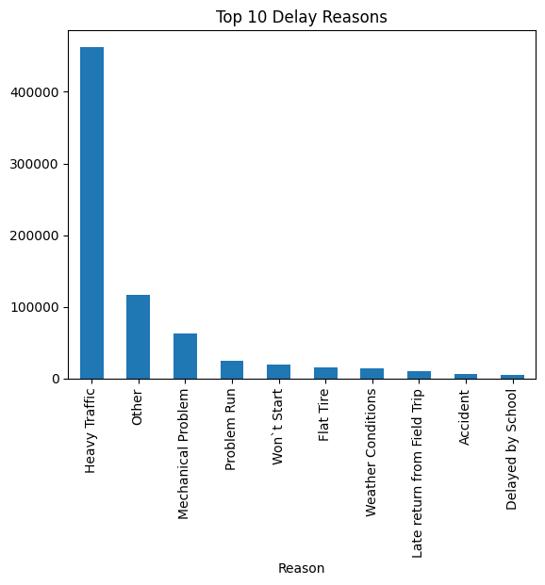
EDA Continued
Chart illustrates why delays occur.
“Other” value can be ambiguous.
Further EDA would give a better
understanding of the “other” value.

Slide 12
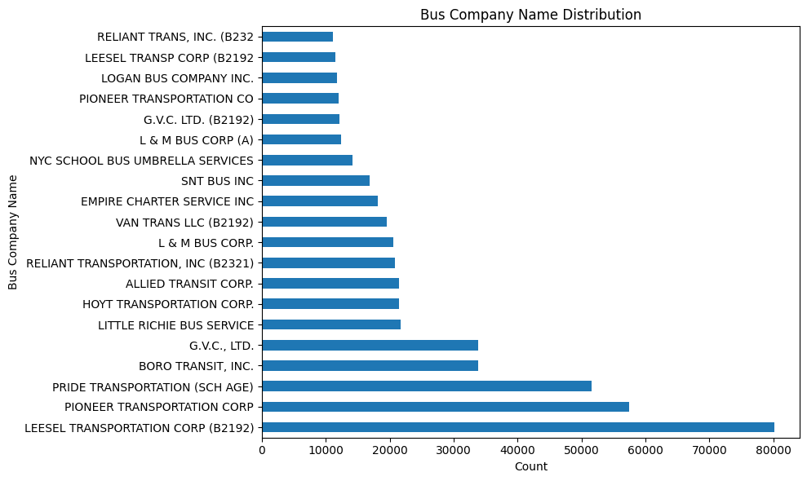
EDA Continued
Highlights the most frequent companies that report bus delays (136 total)
Identifying start and endpoint of routes will allow us to identify specific solutions given certain key features (ex: occurred on, schools serviced, reason, etc.)

Slide 13
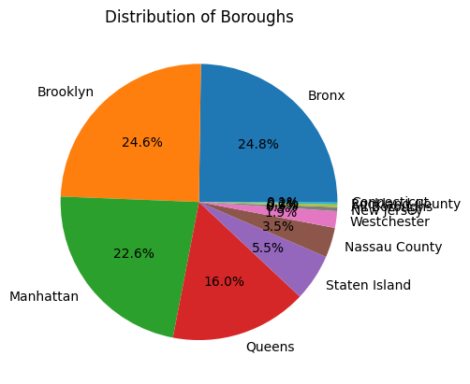
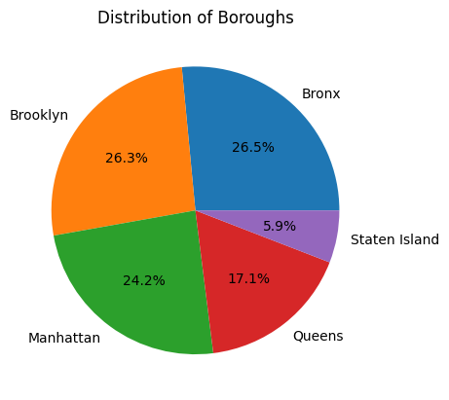
EDA Continued
Our focus is on the cities in New York.

Slide 14
Data Visualizations
Power BI Dashboard or Visual Analytics
Map View: Delay density by city or borough
Charts: Delay reason frequency, Average delay by company and route, YoY trends
Filters/Slicers: School year, company, borough, and delay reason
KPIs: % of breakdowns, Avg delay duration by route or company
Streamlit Web App or Interactive Prediction Tool
User Inputs: Borough, route, bus company, and reason
Model Outputs: Classification: Breakdown or Running Late
Regression: Estimated delay in minutes

Slide 15
Project Timeline
Week 1: Data Acquisition (Nasim, Shobha, James)
Understand the dataset structure and key features. Identify potential data issues (missing values, duplicates, etc.)
Week 4: Data Cleaning (Nasim, Shobha, James)
Complete data cleaning process. Handle missing data, remove duplicates, and standardize fields.
Week 5: Exploratory Data Analysis (EDA) – (Nasim, Shobha, James)
Identify common reasons for delays, Analyze temporal trends (monthly, seasonal, yearly), Examine delay patterns by borough, bus company, and route, Explore relationships between response behavior and delay outcomes.
Week 7: Machine Learning (Nasim, Shobha, James)
Classification Model, Regression Model
Week 8: Frontend Implementation (Nasim, Shobha, James)
Power BI Dashboard or Visual Analytics, Streamlit Web App or Interactive Prediction Tool
Week 9: Final Presentation and Preparation (Nasim, Shobha, James)
Complete data analysis of Predicting School Bus Breakdowns and Delays in NYC. Create the final slides and prepare for project presentation.

Slide 16
Risks or Concerns
Missing or incomplete data: If we drop all rows with missing values (like Delay_Minutes), we might lose most of the dataset, reducing the model’s ability to learn.
Bias in remaining data: The records that are complete may not represent the whole picture. This can cause the model to learn biased patterns and make poor predictions.
Inconsistent reporting: Some columns may have human error or unclear values (e.g., delay reasons typed differently).
Feature importance: Not all features may contribute meaningfully to predictions such as noisy features could misguide prediction.
Real-time prediction needs clean, up-to-date input which may not always be available.

Slide 17
Conclusion
This project will demonstrate how large-scale operational data can be leveraged to improve urban public services. Through combining data science, predictive modeling, and intuitive interfaces, this capstone aims to help NYC’s Department of Education and transit partners make more informed, proactive decisions about school bus logistics.

Slide 18
References
Bus breakdown and delays | NYC Open Data. (2025, June 15).
https://data.cityofnewyork.us/Transportation/Bus-Breakdown-and-Delays/ez4e-fazm/about_data
OPT_Open_Data_Descriptions_V0.2 | NYC Open Data. (2025, June 16).
https://data.cityofnewyork.us/Transportation/Bus-Breakdown-and-Delays/ez4e-fazm/about_data
Transportation status | Baltimore County Public Schools (2025, June 16).
https://www.bcps.org/parents/transportation_status
School Bus Delay | NYC Public Schools (2025, June 15).
https://www.opt-osfns.org/opt/vendors/busbreakdowns/public/default.aspx?search=YES

Slide 19
Questions?
Thank you

